Slide 1
Section 7.4 Conditional Probability with Tree Diagram

Slide 2
Conditional Probability P(B|A)
P(B|A) – the probability that event ‘B’ will occur, GIVEN that event ‘A’ has already occurred
The probability of event “B” may or may not be affected by the occurrence of event “A”
Event “B” is not affected if events “A” & “B” are independent
Event “B” is affected if events “A” & “B” are dependent
Therefore, most conditional probabilities in this section have to do with dependent events
ie: Cards/items drawn without replacement
The probability that “B’ will occur
Given that event ‘A’ has occurred
“given” symbol
© Copyright all rights reserved to Homework depot: www.BCMath.ca

Slide 3
Conditional Probability
To find the probability of event B given the event A, we restrict our attention to the outcomes in A. We then find in what fraction of those outcomes B also occurred.
What is the probability that both Events A and B will occur
Within the probability that event A has occurred
If the events of “A” and “B” are independent, then their conditions will not affect each other.

Slide 4

Independent vs Dependent Events:
Ex: Two marbles are drawn from a jar
Event A: 1st marble is red
Event B: 2nd marble is green
Find P(B|A)
i) There is replacement
(Independent)
ii) There is NO replacement
(Dependent)
Given that the 1st draw is a red marble
When given that the 1st draw is a red marble, the number of red in the jar is decreased
We replaced the red marble back into the jar
The probability that the 2nd marble is green is not affected, because the two events are independent
The probability of getting a green
marble in the 2nd draw is greater
Therefore, if events A & B are independent then:
© Copyright all rights reserved to Homework depot: www.BCMath.ca

Slide 5
Find P(B|A) for each of the following experiments
i) A dice is rolled twice
(A) – 1st roll is even (B) – 2nd roll is odd
ii)(A) – 1st roll is 5 (B) – the sum of the two rolls is 8
iii)(A) – the sum is even (B) – 2nd roll is even
Events ‘A’ and ‘B’ are independent
Events ‘A’ and ‘B’ are Dependent
If the first roll is a 5, then the second roll has to be a ‘3’
List out all the possible even sums:
Events ‘A’ and ‘B’ are Dependent
© Copyright all rights reserved to Homework depot: www.BCMath.ca

Slide 6
Ex: Given the following Venn Diagram, find the probability of the following:
Given that a marble is in circle B
A
B
The probability that it is circle A
Given that a marble is in circle A
The probability that it is in circle B
Given that a marble is in NOT circle B
The probability that it is in circle A
Given that a marble is in circle A or circle B
The probability that it is in circle B
© Copyright all rights reserved to Homework depot: www.BCMath.ca

Slide 7
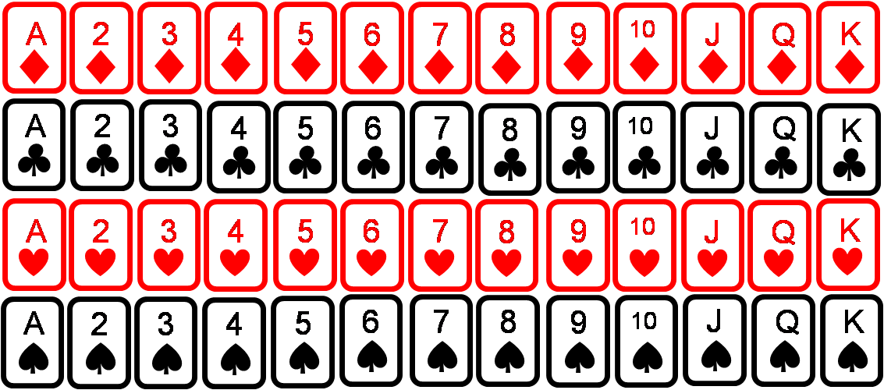
Ex: Two cards are chosen at random without replacement. What is the probability that the 1st card is a face card, and the 2nd card is a club?
(A) – 1st card is a face (B) – 2nd card is a club
Events ‘A’ and ‘B’ are Dependent
Although the 1st card is a face,
it can also be a club
Therefore, the outcome of event A will affect the outcome of event B
© Copyright all rights reserved to Homework depot: www.BCMath.ca

Slide 8
Practice: Two cards are chosen at random without replacement. What is the probability that the 1st card is a red card, and the 2nd card is a face card?
(A) – 1st card is red (B) – 2nd card is a face card
Events ‘A’ and ‘B’ are Dependent
Although the 1st card is a red,
it can also be a face card
Therefore, the outcome of event A will affect the outcome of event B
© Copyright all rights reserved to Homework depot: www.BCMath.ca

Slide 9
There are 16 boys and 18 girls in a class. 4 boys and 6 girls are getting A’s. If one student is selected, Find the probability of each event using a tree diagram
There are 16 boys
4 of them has A’s
All boys getting A’s
Given that a student has an ‘A’, what is the probability that it is a Boy
All students getting A’s
The probability that the student selected will be an A student
All students getting A’s
Total number of students
© Copyright all rights reserved to Homework depot: www.BCMath.ca

Slide 10
A grocery store receives it’s apples from two suppliers: 40% from supplier ‘A’ and 60% from supplier ‘B’. 10% of the apples from supplier ‘A’ are defective and 15% from Supplier ‘B’ are defective. If an apple is chosen at random, then Find the probability of each event:
i) What is the probability that an apple is defective:
ii)Given that an apple is defective, what is the probability that it is from supplier A?
The defective apple can be from either supplier
Find the probability that it’s from supplier A
Probability that an apple is defective and from supplier ‘A’
Probability that the apple is defective
© Copyright all rights reserved to Homework depot: www.BCMath.ca

Slide 11
Challenge: Jar “A” has 3 red and 5 green marbles. Jar “b” has 2 red and 7 green marbles. A marble is chosen from one of the jars and placed into the other one. Then a second marble is chosen from the 2nd jar. What is the probability that the second marble is red?
A
B
Depending on which colour was picked,the number for that color will also increase
There’s a 50-50 chance that
either jar could be chosen
One marble is taken from that jar and placed into the 2nd one
The Probability of getting a red
in the 2nd draw would include
all these cases:
A marble would then be
chosen from the 2nd jar
The number of marbles in the
2nd jar would increase by one
© Copyright all rights reserved to Homework depot: www.BCMath.ca

Slide 12
a) What is the probability that a red marble will be chosen from jar A in the 2nd draw?
b) What is the probability that a green marble will be chosen from jar B in the 2nd draw?
c) Given that the 2nd draw was a red marble, what is the probability that it came from jar A?
Given that it can be any of the 4 cases where a red marble is chosen,
What is the probability that its
from Jar A
© Copyright all rights reserved to Homework depot: www.BCMath.ca

Slide 13
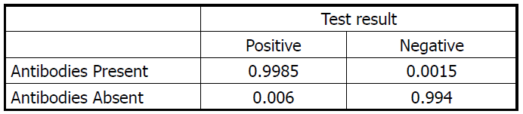
Example –Page 378, #6.64
Ex: Enzyme immuno-assay (EIA) tests are used to screen blood specimens for the presence of antibodies to HIV, the virus that causes AIDS. These antibodies indicate the presence of the virus. The test is 99.85% accurate but is not always correct. Here are approximate probabilities of positive and negative EIA outcomes when the blood tested does and does not actually contain antibodies to HIV. It is estimated that 1% of the population carries antibodies to HIV in their blood.

Slide 14
Note: Someone who is HIV positive may be unaware of their disease. When the EIA test is performed, we don’t actually know their medical condition
A) When someone is tested positive for HIV, what is the probability that he/she is actually HIV positive?
B) When someone is tested positive for HIV, what is the probability that he/she is actually HIV negative?
C) When someone is tested negative for HIV, what is the probability that he/she is actually HIV positive?
D) Many medical professionals would claim that this test is 99.85% accurate, but what does this percentage actually imply?

Slide 15
A) Given that the test shows
positive, what is the probability
that they have HIV
1
1
3
1
2
3
4
B) Given that the test shows
positive, what is the probability
that they don’t have HIV
3
1
3

Slide 16
C) Given that the test shows
negative, what is the probability
that they have HIV
2
2
4
1
2
3
4
D) A 99.85% accuracy in this case implies that the test will detect the antibody 99.85 out of 100 times if you actually have the virus. However, it does not imply that if the test shows positive, then you are 99.85% HIV positive. Instead, if the test shows positive, then there is only 62.7% that you actually have HIV.

Slide 17
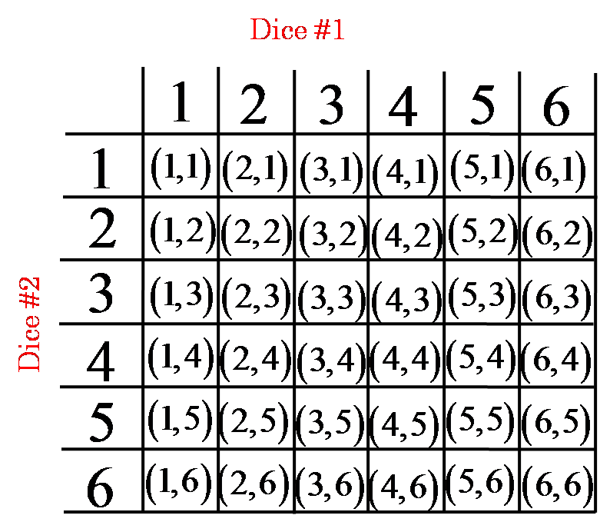
Two fair dice are rolled and it is revealed that one of the numbers rolled was a 4. What is the probability that the other number rolled was a 6?
a) 1/18
b) 1/6
c) 2/11
d) 1/36
Note: The answer is not 1/6
You are given that one of the numbers is 4, this means that both numbers could also be 4
Given that it could any of these 11 outcomes
There are only 2 have also have a 6

Slide 18
A box contains two white marbles and two black marbles. I pick a marble at random and set it aside. Then I pick a second marble and notice that it is black. What is the probability that the first marble was white?

Slide 19
Challenge: Imagine there are a 100 people in line to board a plane that seats 100. The first person in line realizes he lost his boarding pass so when he boards he decides to take a random seat instead. Every person that boards the plane after him will either take their "proper" seat, or if that seat is taken, a random seat instead.
Question: What is the probability that the last person that boards will end up in his/her proper seat
Note: Only the first person has lost his boarding pass, everyone else has their pass
Note: A person only takes a random spot if their seat is taken
Hint: Try a smaller problem
Hint#2: Use a Tree Diagram

Slide 20
Suppose there were only two people {A,B}, what is the probability that the last person gets his own seat?
Person “A: can choose either seat “A” or “B”
If seat “A” is already taken, the second person takes seat “B”
Likewise, if seat “B” is already taken, the second person takes seat “A”
The probability that the last person takes seat “B” is ½
Suppose there were three people {A,B,C}, what is the probability that the last person gets his own seat?
If the 1st person chose seat “A” or “C”, the second person must take seat “B” b/c of his pass
If the 1st person chose seat “B”, then the 2nd
person can randomly choose between “A” or “C”
The 3rd person takes whatever seat is left
The probability that the last person takes seat “C” is 2/4 or also ½

Slide 21
Suppose there were four people {A,B,C,D}, make a tree diagram for the probability that the last person takes seat “D”
The probability that the last person takes seat “D” is 4/8 or also ½
Let’s do the same things if there were five people{ABCDE}
From these tree diagrams, we can see that the only seat the last
person can take is either “A” or “E’ {last seat}, so it will always be 50%

Slide 22
Another way to perceive this problem is that up until the last person, every seat from the second pass to the second boarding pass will be taken by someone
Ie: All seats from boarding pass “B” to the second last seat must be taken by a passenger
For instance, any seat except the last one will be taken either by someone earlier or by the person holding its boarding pass
So only two seats will not be guaranteed to be taken: which is the first and last ones. Since each one is likely to chosen, the probability is 50%

